Slide 1
Progress Meeting
4/3/19
Let’s get down to business

Slide 2
Agenda
Progress on code
Prototype #3
Showcase

Slide 3
Progress on code
Working interface between MSP430 and comms chip ✓
Found C driver for accelerometer → working on understanding and integrating
Notes:
Msp430, comms chip was working at affiliates day
Working on accel tonight at working meeting

Slide 4
Prototype #3
Soldered one version ✓
Tested Sensor Board ✓
Tested Comms Board (first board tested was bad, second board seemed to work fine) ✓
Tested Power Board - Had to wait on solar cells, planning to test today or tomorrow
Notes:
Soldered one version of the board
Nathaniel, Robby did comms board test, range test on one board revealed that one’s bad
Moved on with a different one
Power- solar cells arrived, so need to test those this week (Rachel)
2 configs, 66% as good and 75% as good as what we were using originally

Slide 5
Showcase
CHARIoT sign finished ✓
Update Poster?
Demo
1+ node measures temperature ✓
Heat gun
1 node measures acceleration
Punch a bag with node inside?
1 node (no power board) controlling LEDs of CHARIoT sign
“Adjustable” light sequence controlled by tablet app
“Auto” mode gets temperature data from tablet and reacts
Discuss: Have tablet report state of battery to show dynamic power control?
Notes:
Demo nodes- issues are wakeup time to tx
Transmit battery state?
Sensor nodes around Tudor fieldhouse- demo range

Slide 6
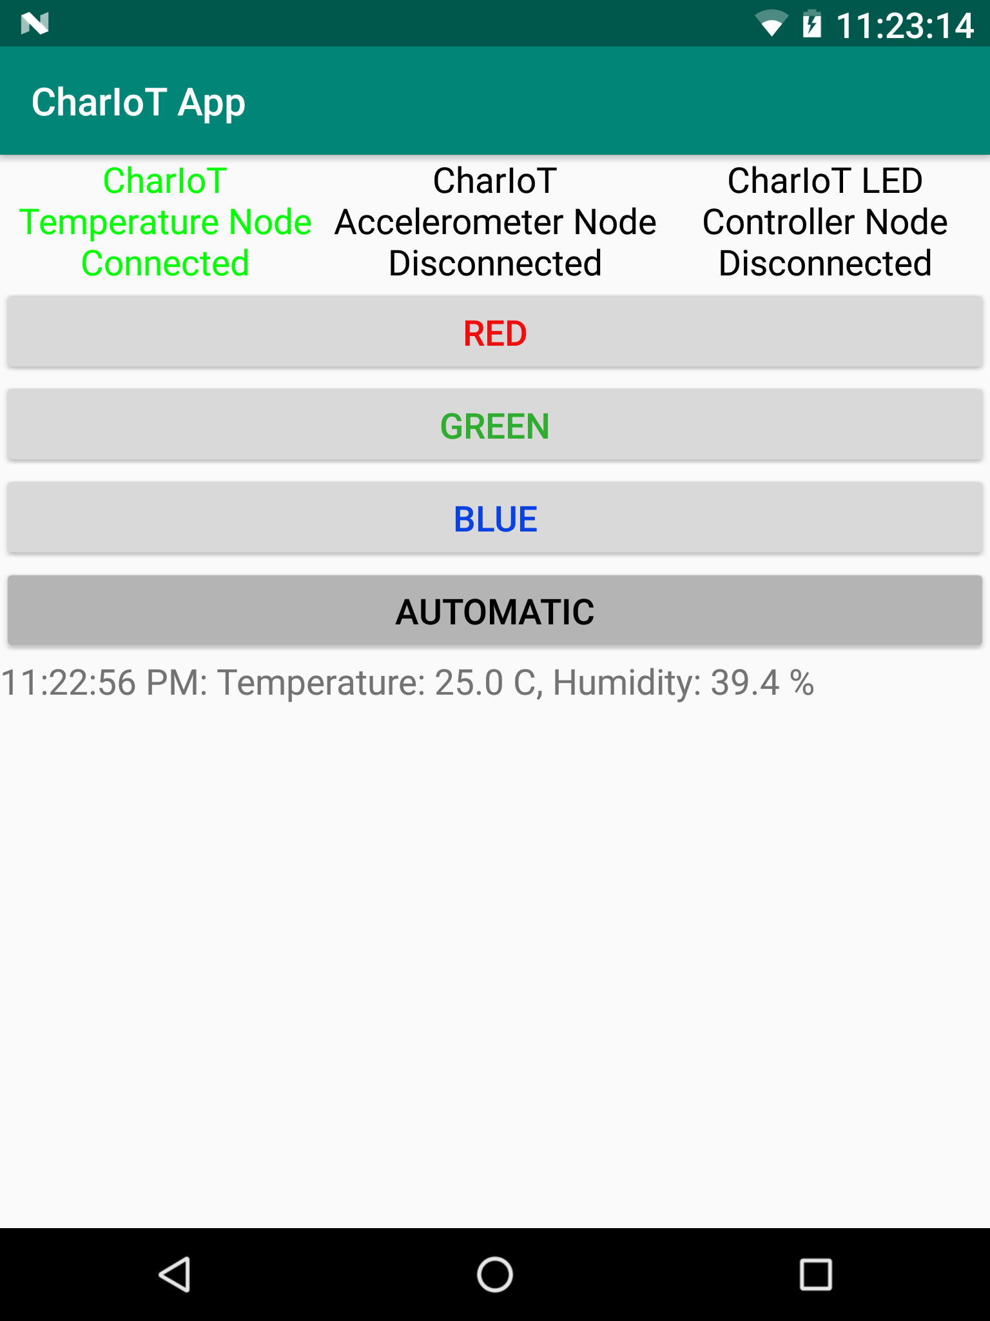
Android
App
Example
Notes:
Good job Nathaniel!

Slide 7
Showcase Continued
Hoping to have demo finalized and ready to go by Sunday
Print poster, practice talking, plan outfits, and breathing heavily from then til showcase
After showcase:
Cry
Celebrate
Drink booze
Documentation
Talking points brainstorming:
Prepare answers for power questions: important part of project
Connect to application a little more: probably why Axon won
Focus less on future plans, more on what makes our project cool now
Notes:
Talking points-
Go talk to Tracy Volz
GW has office hours between now and showcase each night 10-midnight
Power questions: prep answers
Connect to application- how the nodes can be used
How is it going to be used?
IoT, beyond state of the art (cannot buy this elsewhere)
“Characterize the hell” out of your power
Power- do worst-case analysis (ie not receiving more light in a hurricane, how long would it be able to tx 1time/hr)
Get ambient light reading (just sitting on a table in a room not right under a lightbulb)
Icons to make the chart more visual

Slide 8
Miscellaneous
Signed up for final review slot ✓
What needs to happen before Sunday night:
Temperature node working ✓
Accelerometer node working
LED control node working ✓
App finalized ✓
Fuel gauge somehow measuring battery status✓
Power board tested
Finalize what stays in demo and poster
“Uniform” decided upon
I’m just saying, some teams have matching outfits
Notes:
Business attire

